Slide 1
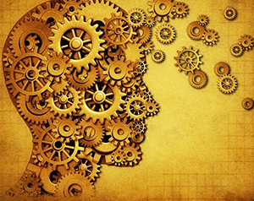
Logic
By Ariel Avshalom
Lecture 1
CISC 2210

Slide 2

Logic, the bane of humanity
Logic, like all constructions is a tool
This tool is used to develop reasonable conclusions based on data
However, humans are social creatures and we don’t do well with cold hard logic

Slide 3
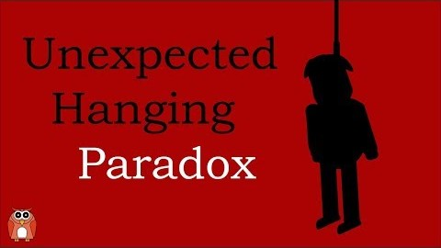
An example: The Unexpected Hanging

Slide 4
Viral logic puzzle
Which answer in this list is the correct answer to this question?
All of the below
None of the below
All of the above
One of the above
None of the above
None of the above

Slide 5

Roots of logic
The roots of logic share a connection between India, China and Greece
The Greek way of thinking has permeated into Western Science and math
Lots of Greek logic had to do with proving geometric relations
They liked geometry because they felt it had more substance than algebra

Slide 6
Our goal
To show that some statement or a declarative sentence is true or false
To verify a proposition
To validate an argument

Slide 7
Statements
A sentence or mathematical expression which is definitely true or definitely false
This means that something which is not definitely true or false is not a statement (the below are not statements)
Add 5 to both sides.
42
What is the solution of 2 x 84?

Slide 8
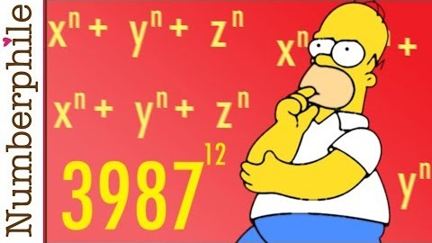

Some confounding mathematical statements
Fermat’s Last Theorem:
$For all numbers a,b,c ∈ ℕ with n>2, a^{n}+b^{n}≠c^{n}$
It took Andrew Wiles hundreds of pages to prove this
Goldbach's Conjecture:
Every even integer greater than 2 is the sum of two prime numbers

Slide 9
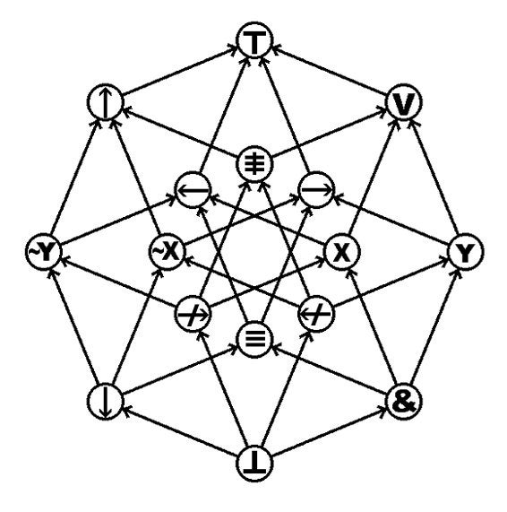
Connectives
There are several basic connectives in logic
Let p and q be statements:
¬p: NOT p
p ∨ q: p OR q
p ∧ q: p AND q
p ⇒ q: p IMPLIES q

Slide 10
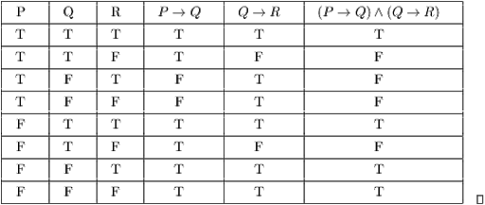
Truth Tables & Propositional Calculus
They’re used to graphically represent the truth values of usually complex propositions (arguments)
All of this fits into a field called propositional calculus

Slide 11
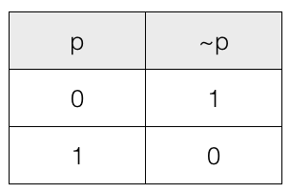
¬ (Not)

Slide 12
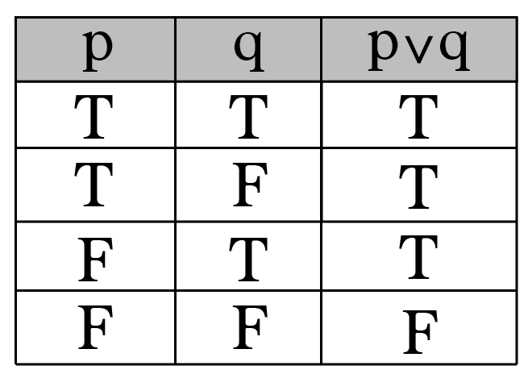
∨ (Or)

Slide 13
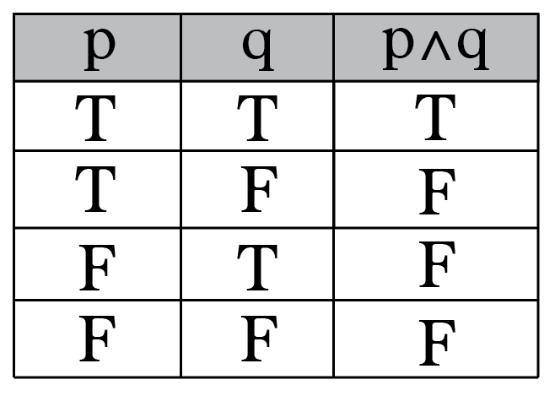
∧ (And)

Slide 14
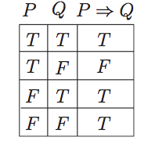

⇒ (Implies)

Slide 15
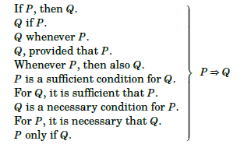
Converting words to truth tables
Words are ambiguous and math isn’t so learn to convert between the two:

Slide 16
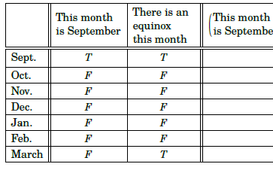
Conditionals are dangerous

Slide 17
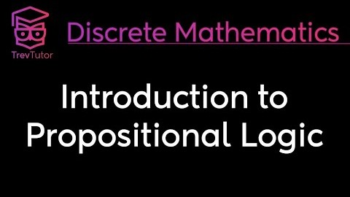
An awesome intro video

